Slide 1

Policy Gradient Methods (I): Basics Keshav Pingali

Slide 2
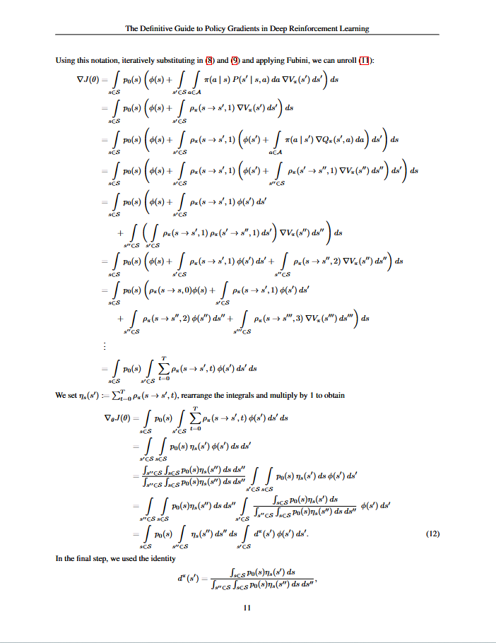
Standard presentations vs. this one
Difficult concepts
Gradient of expectation of reward at start state
Variance of gradient of expectation of reward of the start state
Continuous state MDP: expectations are integrals
No abstraction or visualization
No obvious connection to deterministic control MDPs, Bellman iteration etc.
Many poor explanations on the web
Difficult concepts: use abstraction
Gradient of expectation of reward at start state
Variance of gradient of expectation of reward of the start state
Finite-state MDP: expectations are sums
Visualization of probabilistic policies
Start with Bellman iteration
Simple explanation
“The definitive guide to policy gradients in Deep RL” Lehmann 2024

Slide 3
Organization
Deterministic and probabilistic control
Policy network and its parameters θ
Basic policy gradient method: REINFORCE
Monte Carlo sampling to estimate gradient of expected reward
Suffers from high variance → requires many samples
Baseline methods for reducing variance
Based on control variates methods from Monte Carlo literature
Use advantage in place of reward
Implementation: actor-critic methods
Trust-region methods for improving stability and sample efficiency
Ensure updates to θ are small
Trust Region Policy Optimization (TRPO): KL-divergence
Proximal Policy Optimization (PPO): bounding box around current values

Slide 4
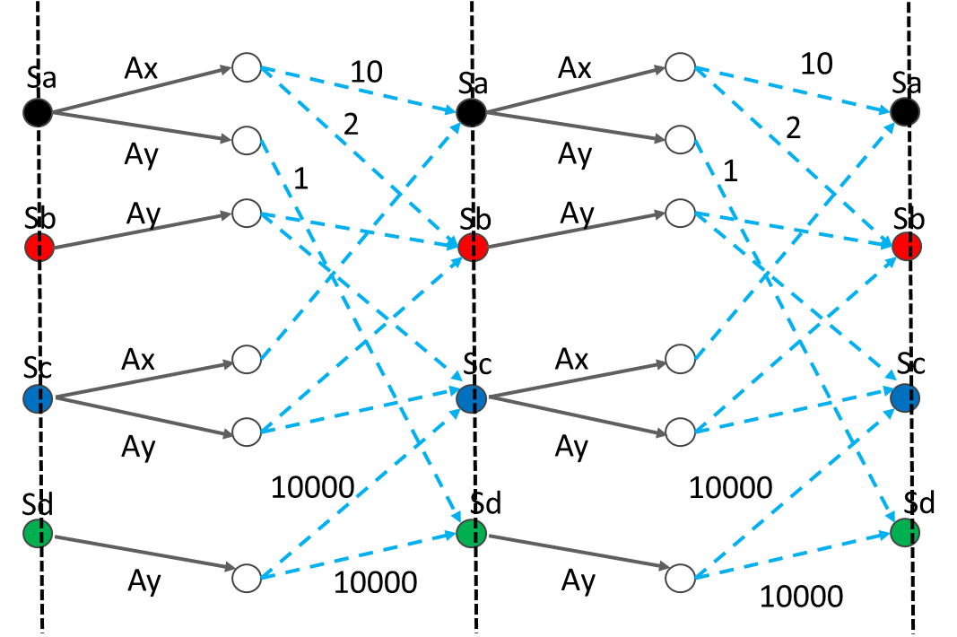
Discrete-time finite-state MDP
T
t=0
t=1
t=2
t=3
t=4
S: set of states (possibly infinite but in this presentation, finite)
Initial state specified
A: set of actions (possibly infinite but in this presentation, finite)
Step: <State, Action, Reward, State>
Agent is in some state, takes action, observes reward and transitions to next state
Reward and next state are probabilistic because of environment
Episodic task: task ends after T steps
Continuous tasks: no notion of end; not considered in this presentation

Slide 5
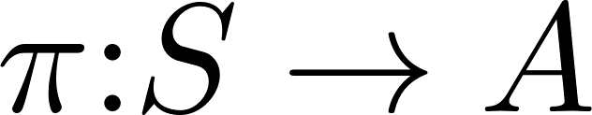
MDP policies
Deterministic policy
Policy: State → Action
Objective function: expected reward at end of episode
Finding optimal policy: iterated policy evaluation and policy improvement
Probabilistic policy
Policy network maps current state to action distribution
Sampler samples distribution to generate an action
Objective function: expected reward at end of episode
Finding optimal policy: gradient ascent in θ to maximize expected reward at start state
Advantages: handles continuous state and action spaces, exploration-exploitation dilemma
J^{θ}(S0)
θ = θ + η∇_{θ} J^{θ}(S0)
State s
Θ
Policy Network
Probability of action 1
Sampler
Action 3
Next state
Probability of action 2
Probability of action 3
Probability distribution of actions given state s

Slide 6
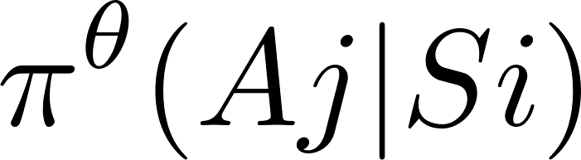
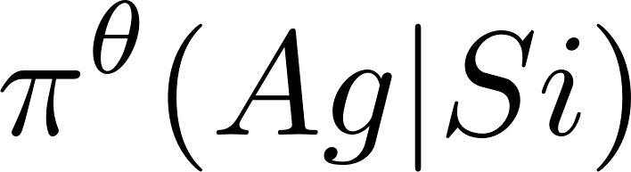
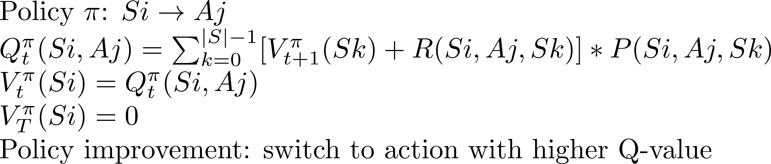
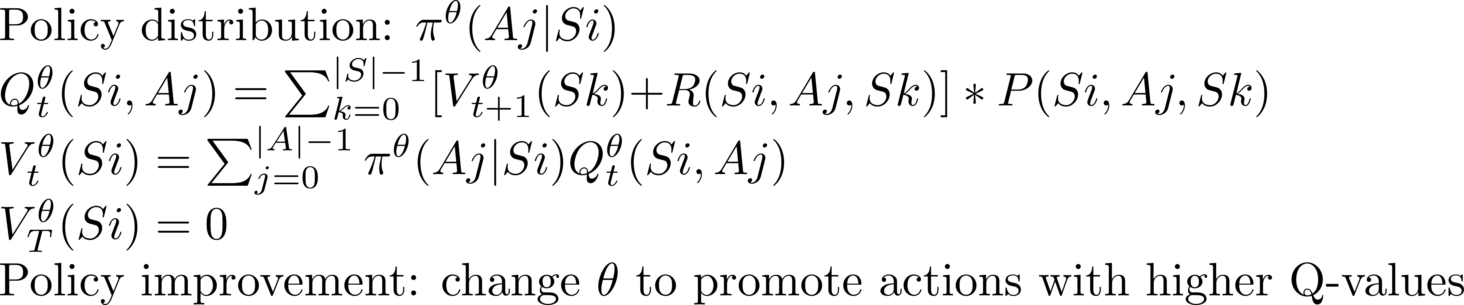
Policy evaluation: Bellman iteration
t
t+1
t
t+1
A1
P(Si,Aj,Sk)
R(Si,Aj,Sk)
Sk
P(Si,Aj,Sk)
R(Si,Aj,Sk)
Sk
Q_{t}^{π}(Si,Aj)
A1
Q_{t}^{θ}(Si,Aj)
…..
Aj
Aj
Si
…..
Si
Ag
Ag
V_{t}^{π}
V_{t+1}^{π}
V_{t}^{θ}
V_{t+1}^{θ}
Deterministic control
Probabilistic control

Slide 7
Simplify MDP: eliminate Q-nodes
t
t+1
t
t+1
t
t+1
Q_{t}^{θ}(Si,Aj)
Sk
*P(Si,Aj,Sk)
R(Si,Aj,Sk)
Sk
Sk
P(Si,Aj,Sk)
R(Si,Aj,Sk)
*P(Si,Aj,Sk)
R(Si,Aj,Sk)
Aj
Si
Aj
Si
R(Si,Ag,Sk)
Si
R(Si,Ag,Sk)
P(Si,Ag,Sk)
Ag
Ag
*P(Si,Ag,Sk)
V_{t}^{θ}
V_{t+1}^{θ}
V_{t}^{θ}
V_{t+1}^{θ}
V_{t}^{θ}
V_{t+1}^{θ}
Multigraph: states at successive time-steps connected by edges
Each edge has probability and reward

Slide 8
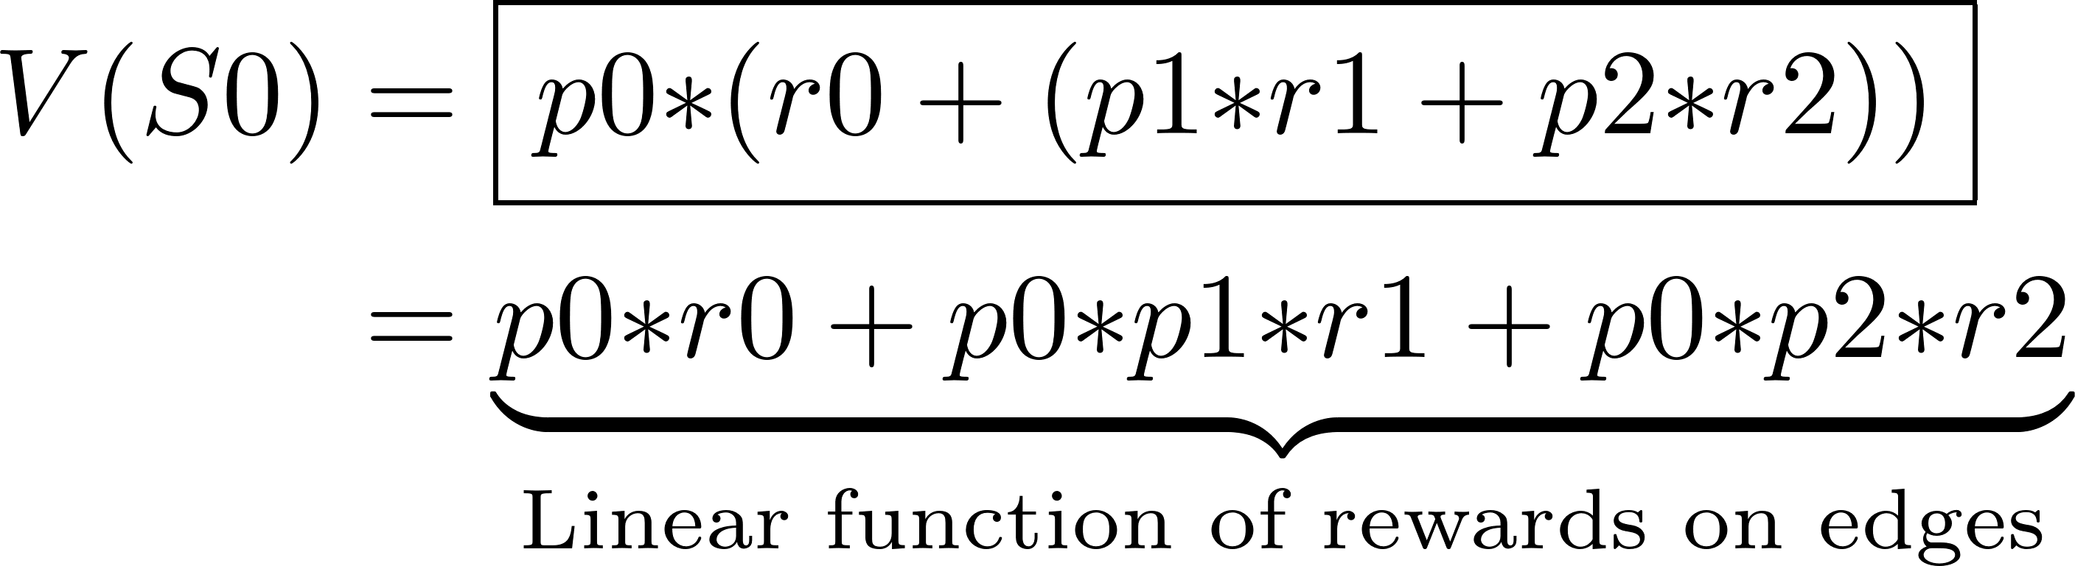
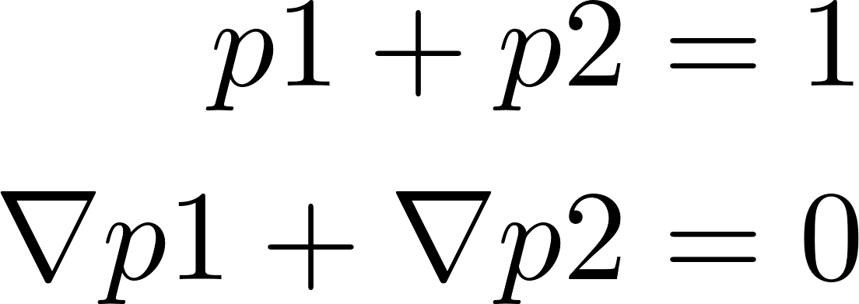
Example
t
Bellman:
S0
0
_{p0,r0}
1
_{p1,r1}
_{p2,r2}
2

Slide 9

Estimating valuations and gradients of valuations
Bellman-style bottom-up computation
Exact but expensive
Requires transition dynamics: P(Si,Aj,Sk)
Solution: Monte Carlo sampling
Three steps
Unroll recursion (conceptually): simplifies mental picture
Think in terms of trajectories, not level-by-level computation
Express expected rewards in terms of expectations over trajectories

Slide 10
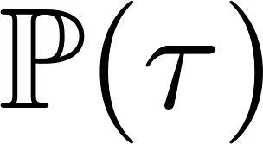
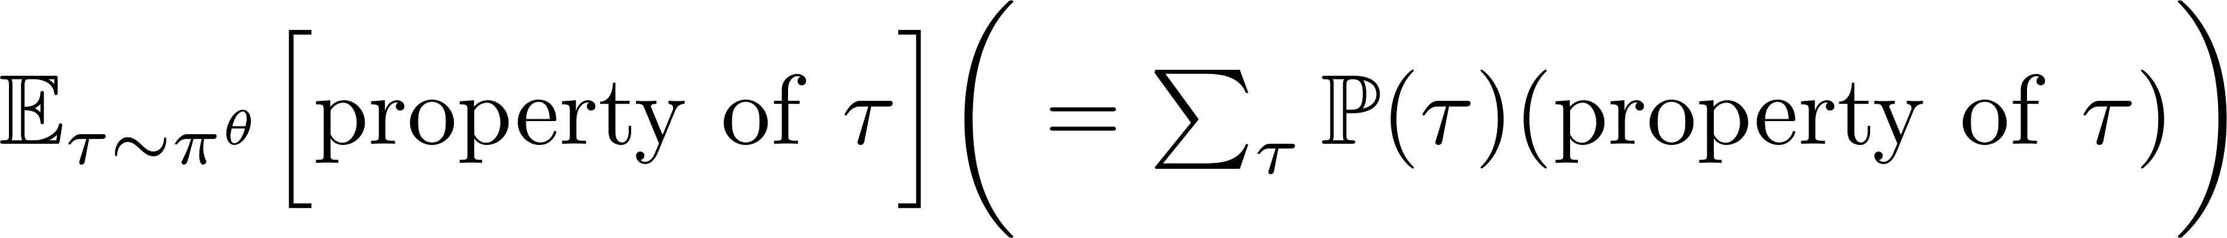
Unrolling recursion (conceptual)
time
DAG rooted at start state S0
Easy extension: start state can be any state
Each edge is labeled with probability and reward
Sum of probabilities on outgoing edges of node = 1
Trajectory: τ ∈ π^{θ} path from root to a leaf
Probability of trajectory τ : = product of edge probabilities
Reward of trajectory τ : R(τ) = sum of rewards on trajectory
Sum of trajectory probabilities = 1
Meaningful to talk about
S0
0
V₀^{θ}
pi,ri
1
V₁^{θ}
Sk
……..
……..
……..
Si
V_{t}^{θ}
t
t+1
V_{t+1}^{θ}
Sk
t+2
V_{t+2}^{θ}
……..
……..
……..
V_{T-1}^{θ}
T-1
V_{T}^{θ}
T

Slide 11
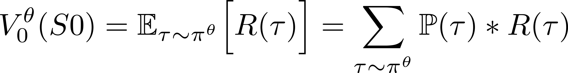
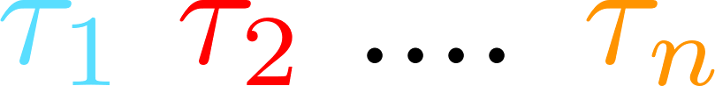
Relating Bellman-style iteration to trajectories
S0
S0
V₀^{θ}
pi,ri
Claim:
V₁^{θ}
Sk
……..
……..
……..
Si
Expectation is top-down “depth-first” computation:
for each trajectory
sum up rewards
multiply by trajectory probability
V_{t}^{θ}
V_{t+1}^{θ}
Sk
V_{t+2}^{θ}
……..
……..
……..
Claim: Bellman bottom-up, level-by-level computation gives same answer as top-down “depth-first” computation
V_{T-1}^{θ}
Bellman
iteration
V_{T}^{θ}

Slide 12
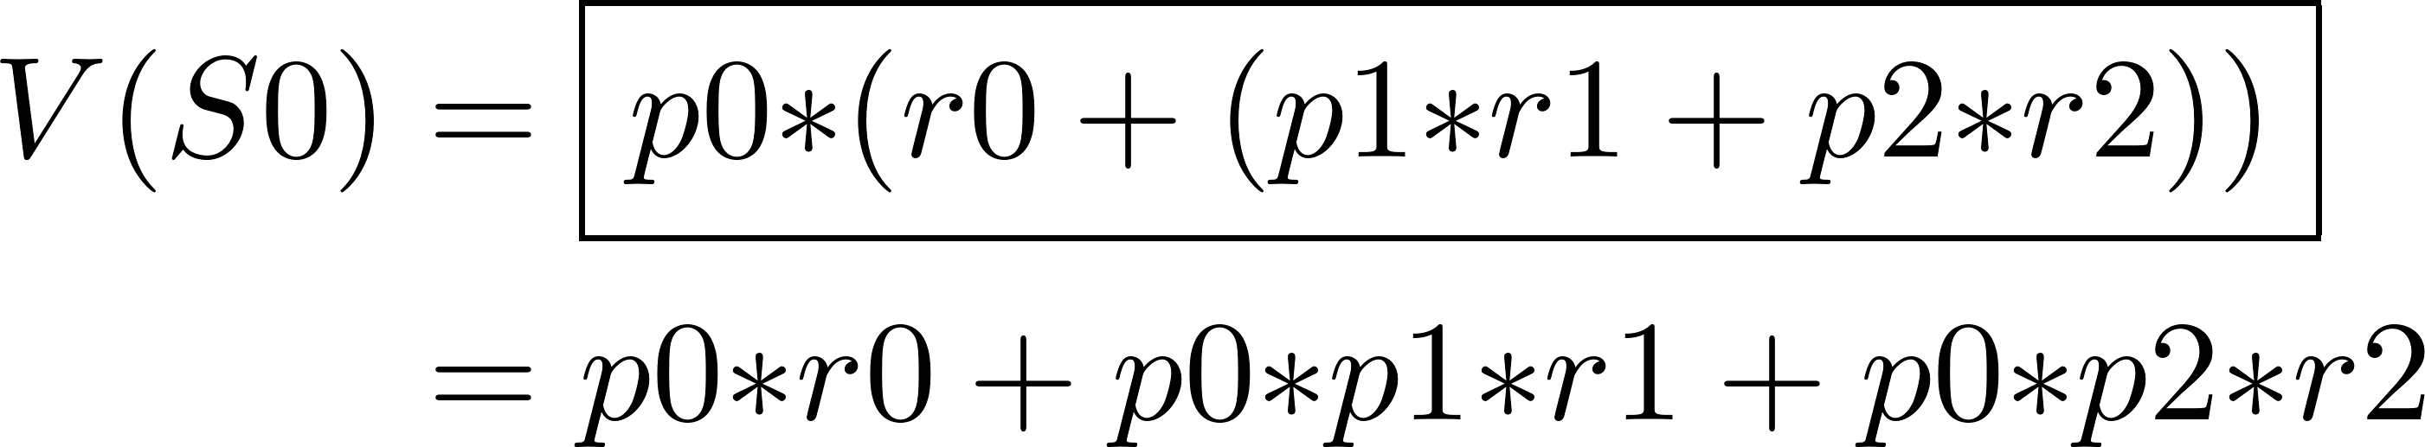
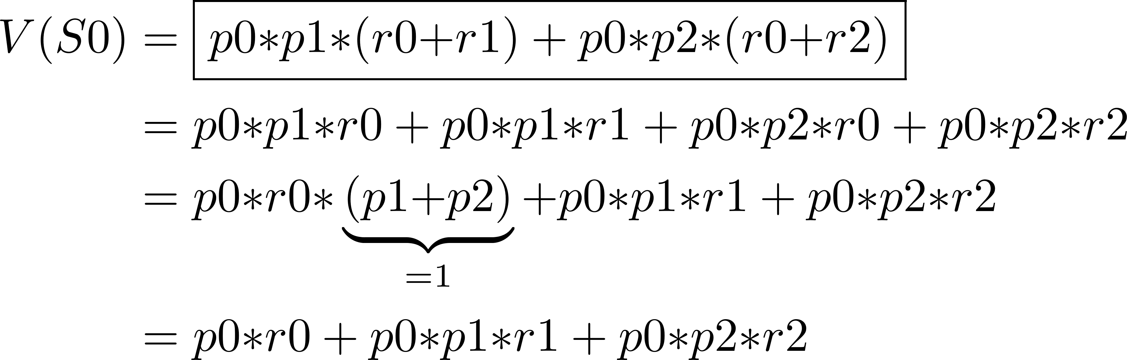
Example
Bellman:
Trajectories:
S0
_{p0,r0}
_{p1,r1}
_{p2,r2}
Intuition: contribution of each edge to expected reward is distributed over trajectories that contain it

Slide 13
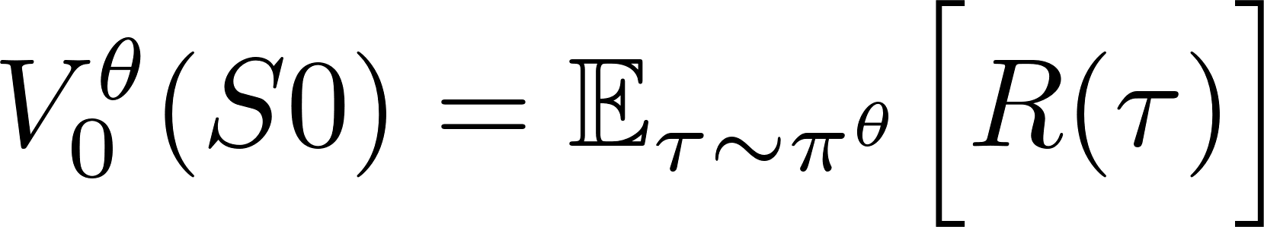
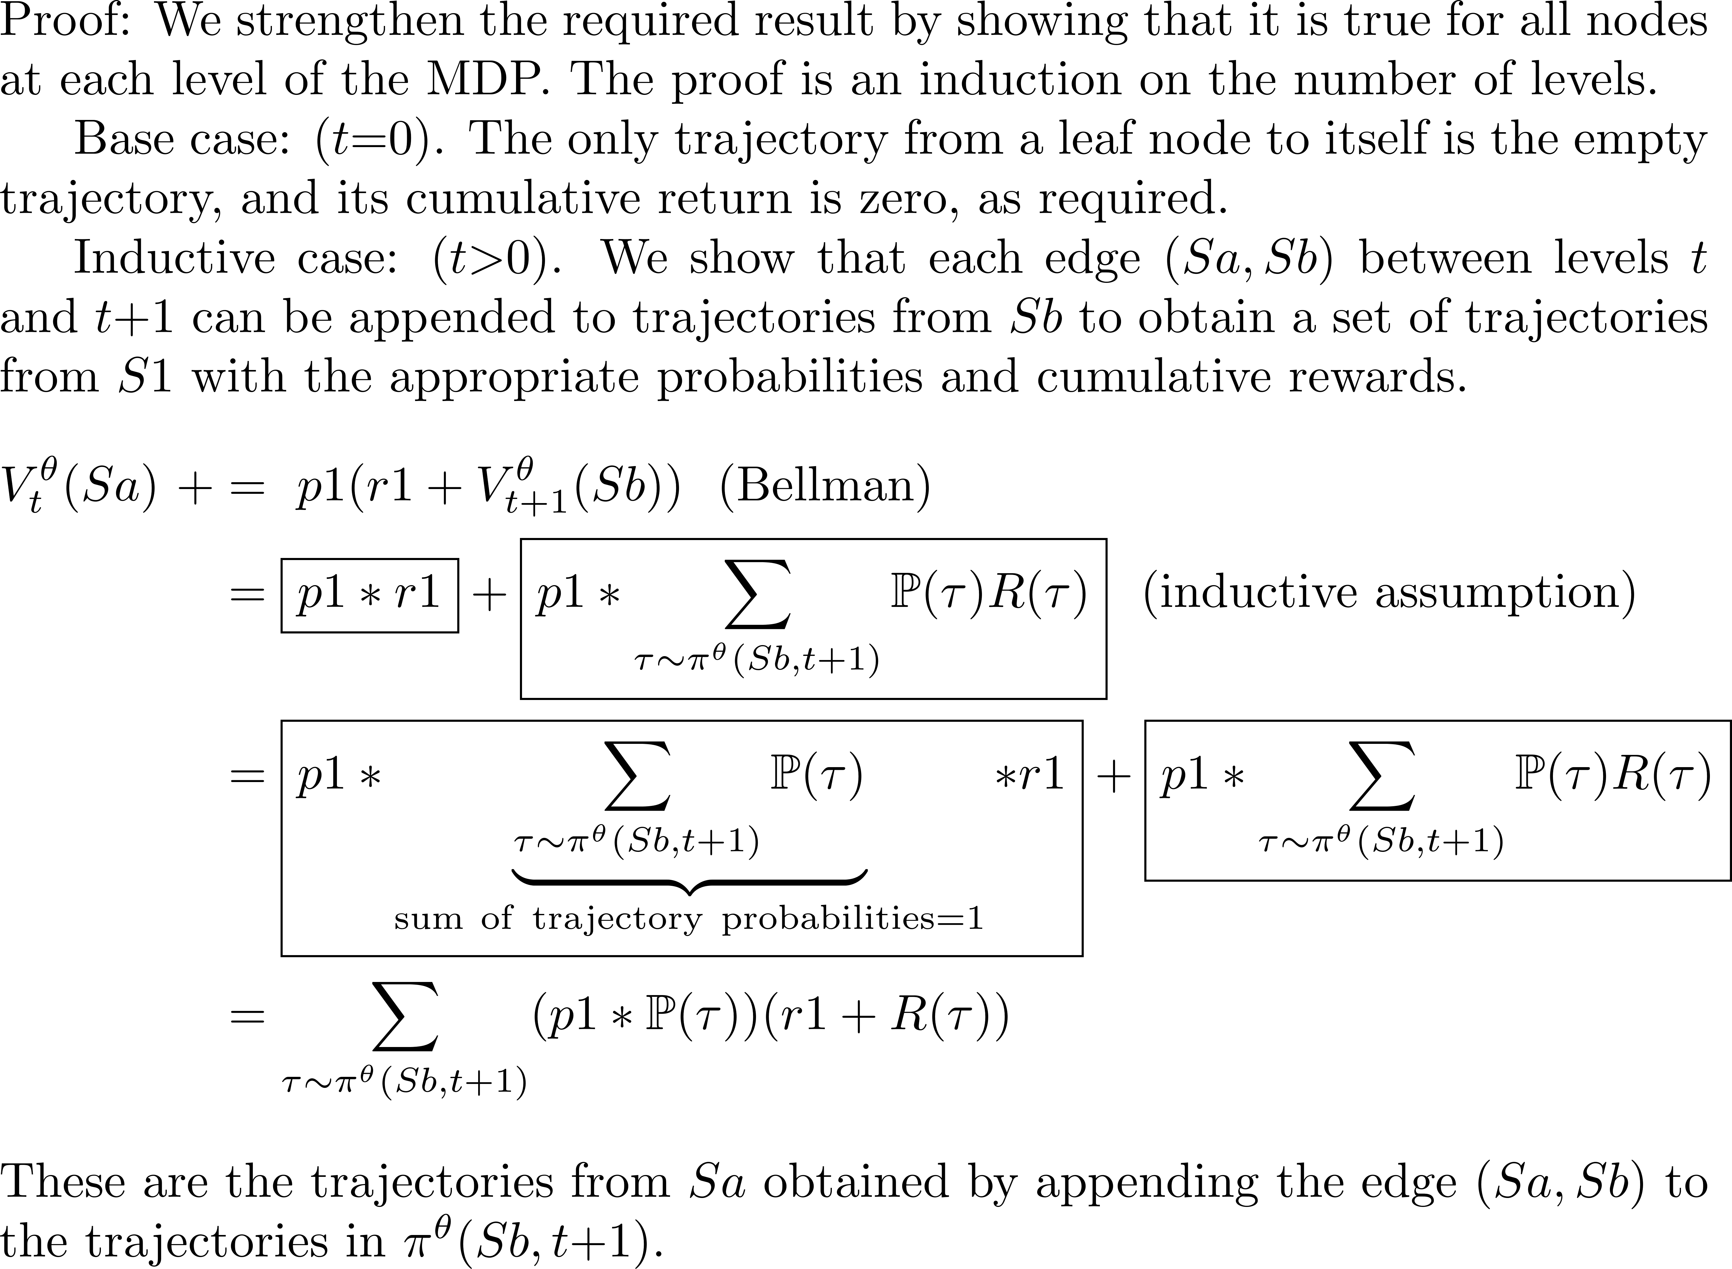
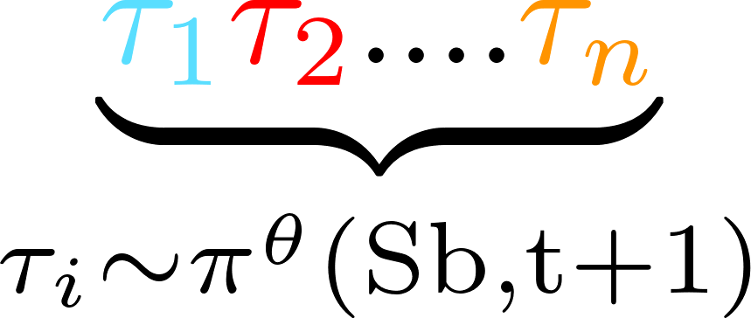
S0
V₀^{θ}
V₁^{θ}
……..
……..
Sa
V_{t}^{θ}
Bellman step
p1,r1
Sb
V_{t+1}^{θ}
V_{t+2}^{θ}
Inductive
assumption
……..
……..
V_{T-1}^{θ}
V_{T}^{θ}

Slide 14
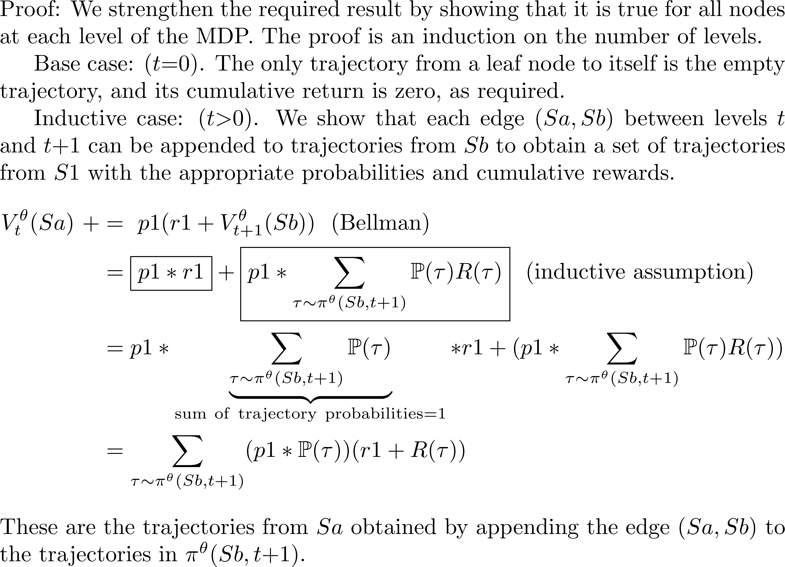
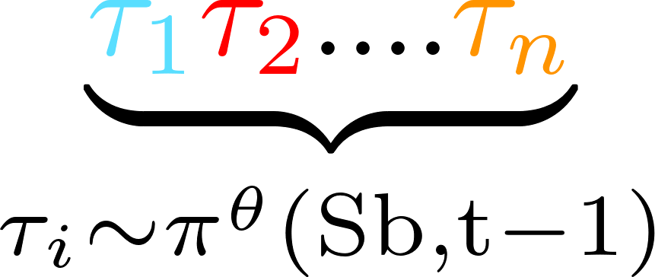
S0
V₀^{θ}
V₁^{θ}
………………………………….
Sa
Bellman
iteration
V_{t}^{θ}
Sb
p1
V_{t+1}^{θ}
V_{t+2}^{θ}
Inductive
assumption
………………………………….
V_{T-1}^{θ}
V_{T}^{θ}

Slide 15
S0
V₀^{θ}
V₁^{θ}
Sa
Bellman-like
iteration
V_{t}^{θ}
Sb
p1,r1
V_{t+1}^{θ}
V_{t+2}^{θ}
Inductive
assumption
………………………………….
V_{T-1}^{θ}
V_{T}^{θ}

Slide 16
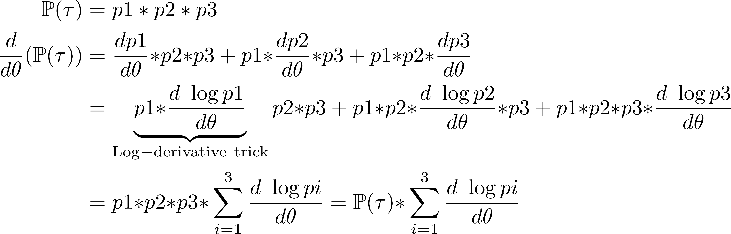
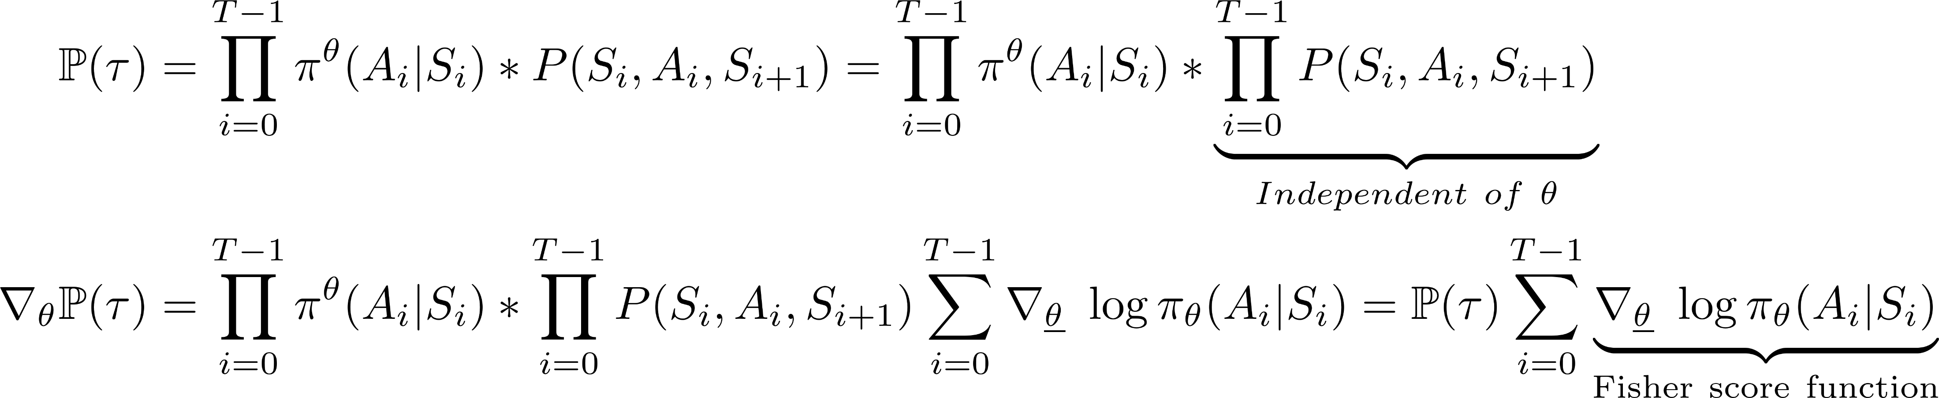
Gradient of path probability
τ:
p1
p2
p3
τ:
S₀
A₀
S₁
A₁
S_{T}
……..
π^{θ}(A₀|S0)*P(S₀,A₀,S₁)
π^{θ}(A₁,S₁)*P(S₁,A₁,S₂)

Slide 17
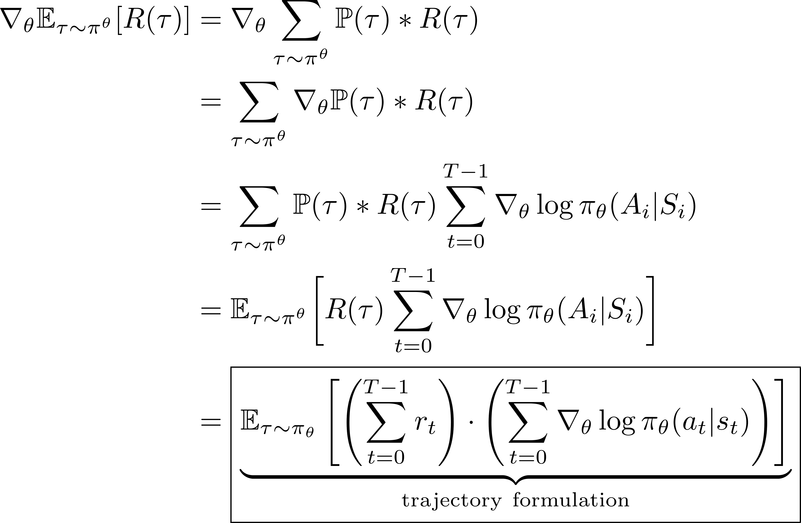
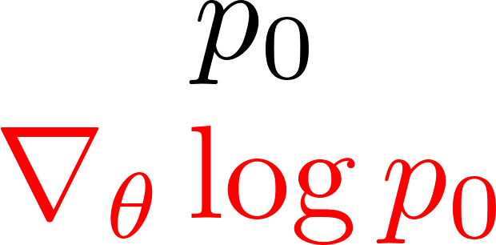
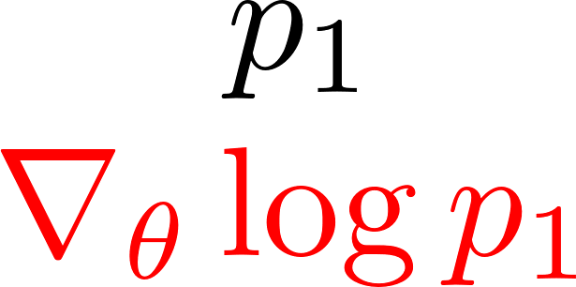
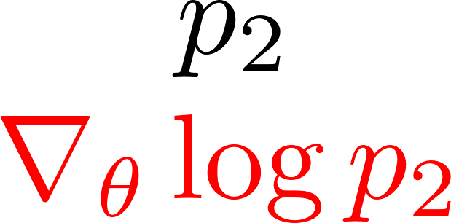
Gradient of expected return
t
τ:
r₀
r₁
r₂
Every reward multiplied by log prob of every edge

Slide 18
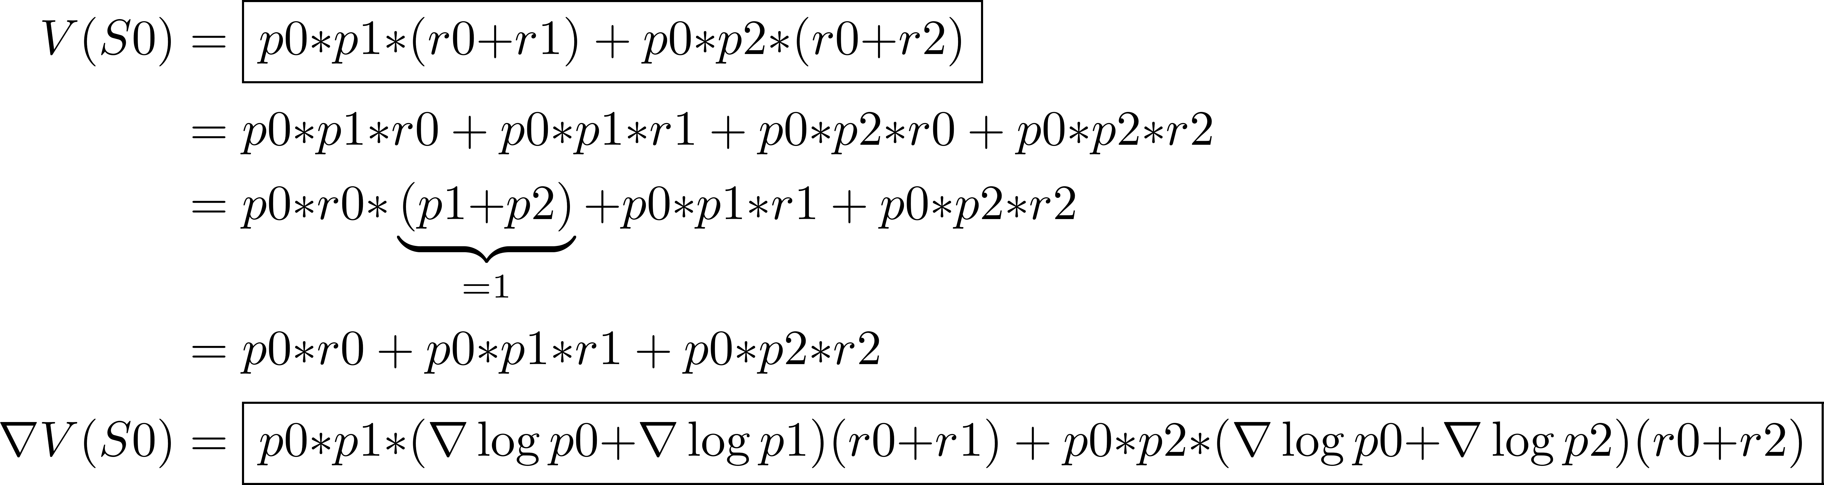
Example
Bellman:
Trajectories:
S0
_{p0,r0}
_{p1,r1}
_{p2,r2}

Slide 19
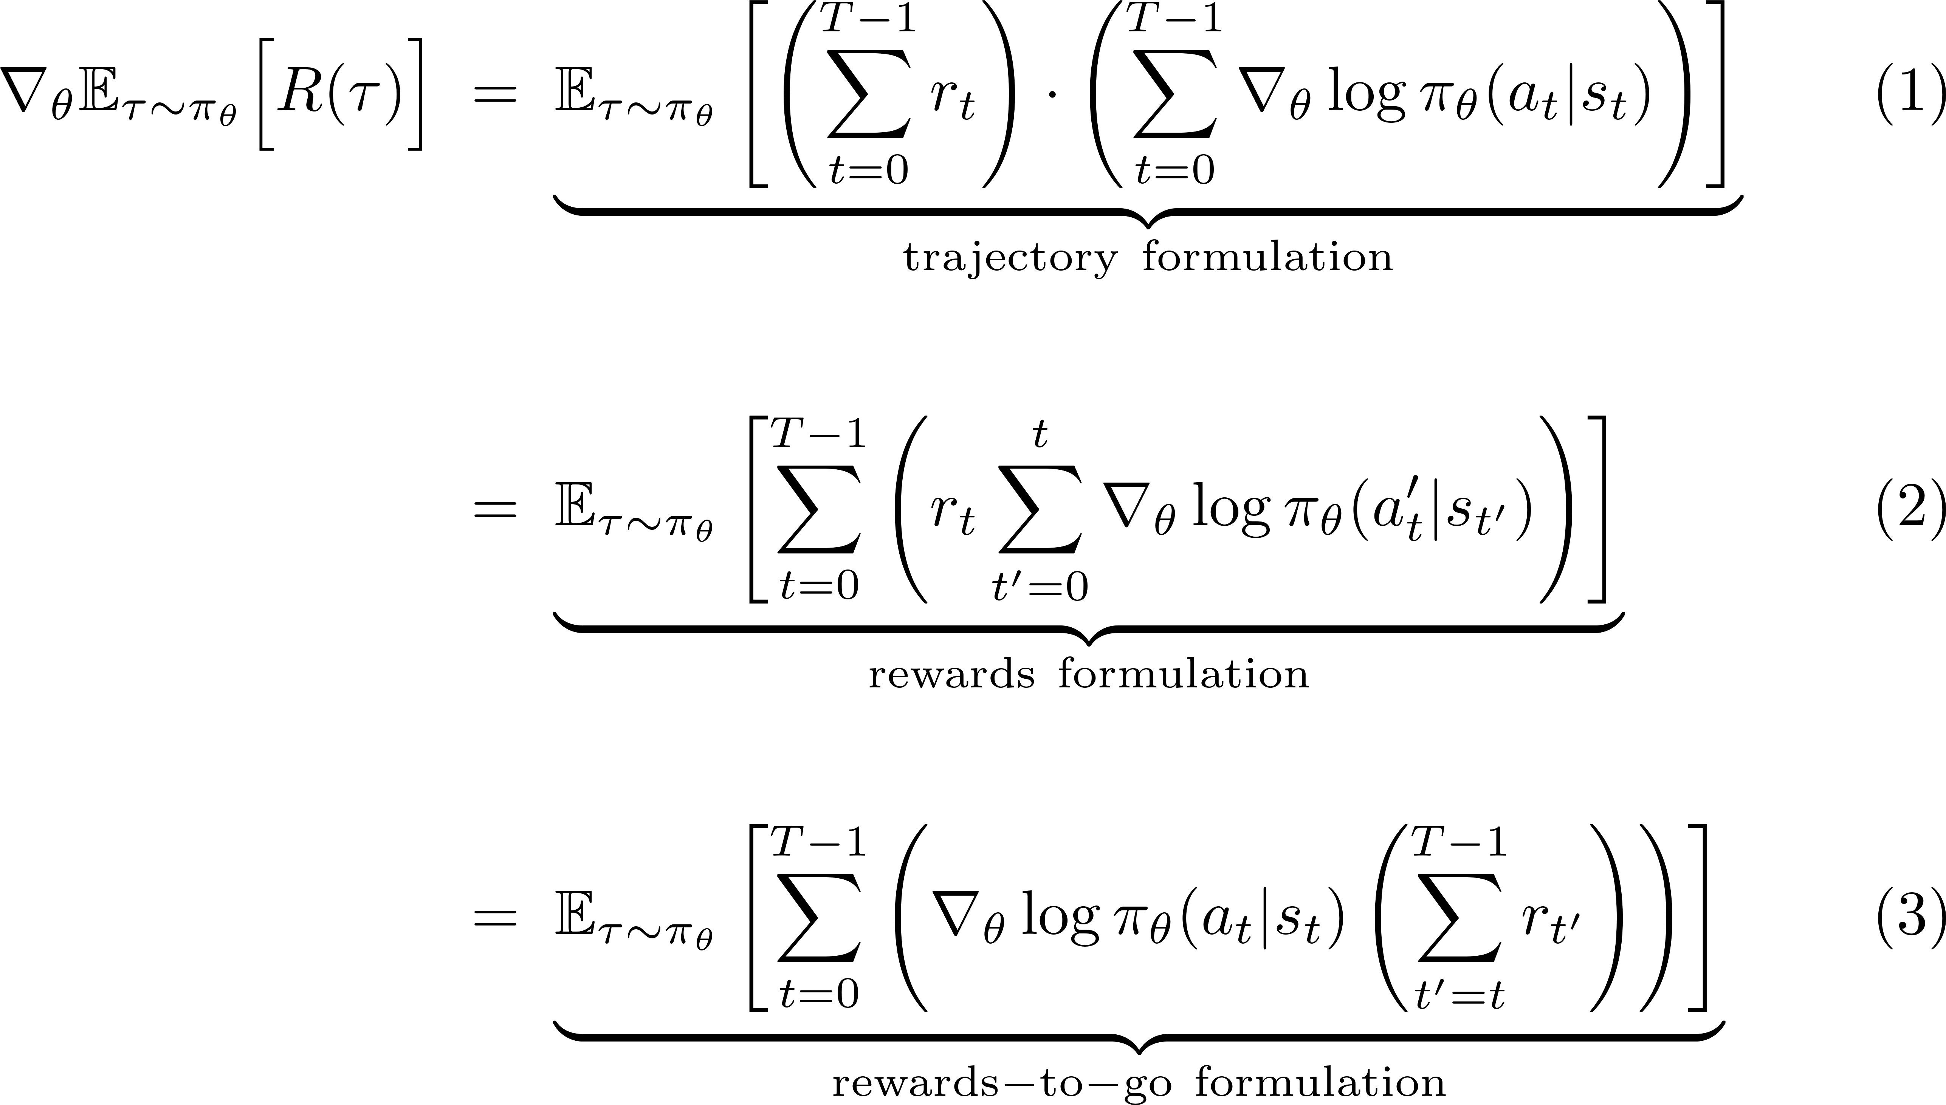
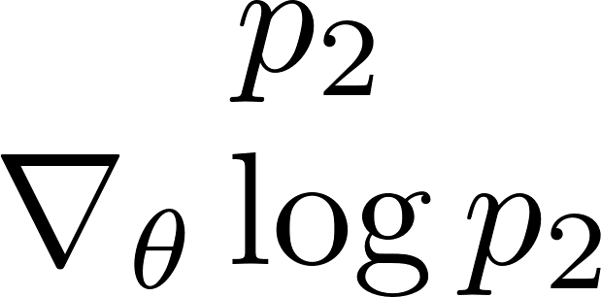
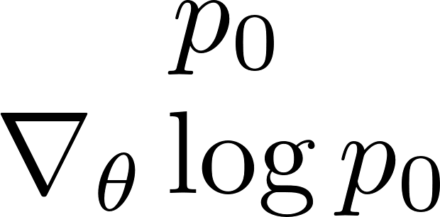
Gradient of expected return: other formulations
t
τ:
r₀
r₁
r₂
τ:
r₀
r₁
r₂
τ:
r₀
r₁
r₂
Formulations (2) and (3) are obviously equivalent:
each reward is multiplied by log prob’s earlier in trajectory and summed
https://danieltakeshi.github.io/2017/03/28/going-deeper-into-reinforcement-learning-fundamentals-of-policy-gradients/

Slide 20
Example
Bellman:
Trajectory:
Reward formulation:
Rewards-to-go formulation:
S0
_{p0,r0}
_{p1,r1}
_{p2,r2}

Slide 21
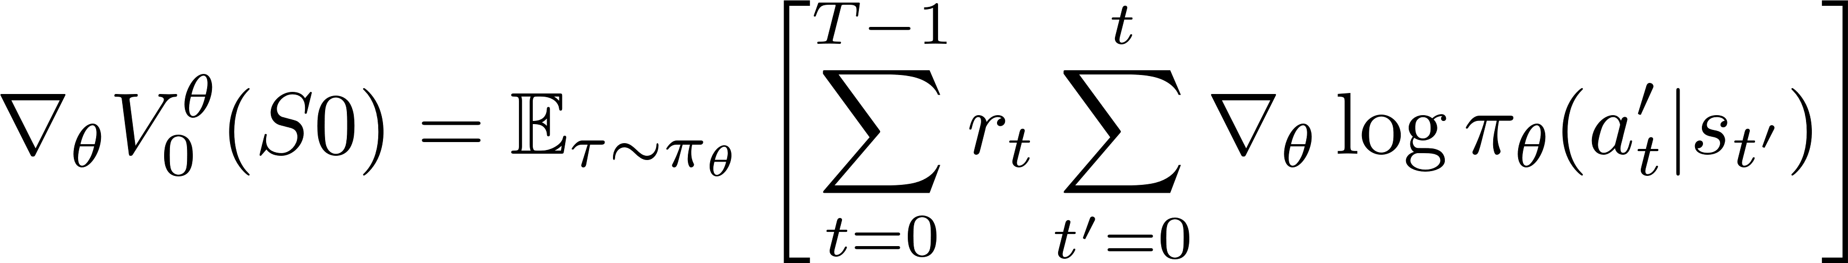
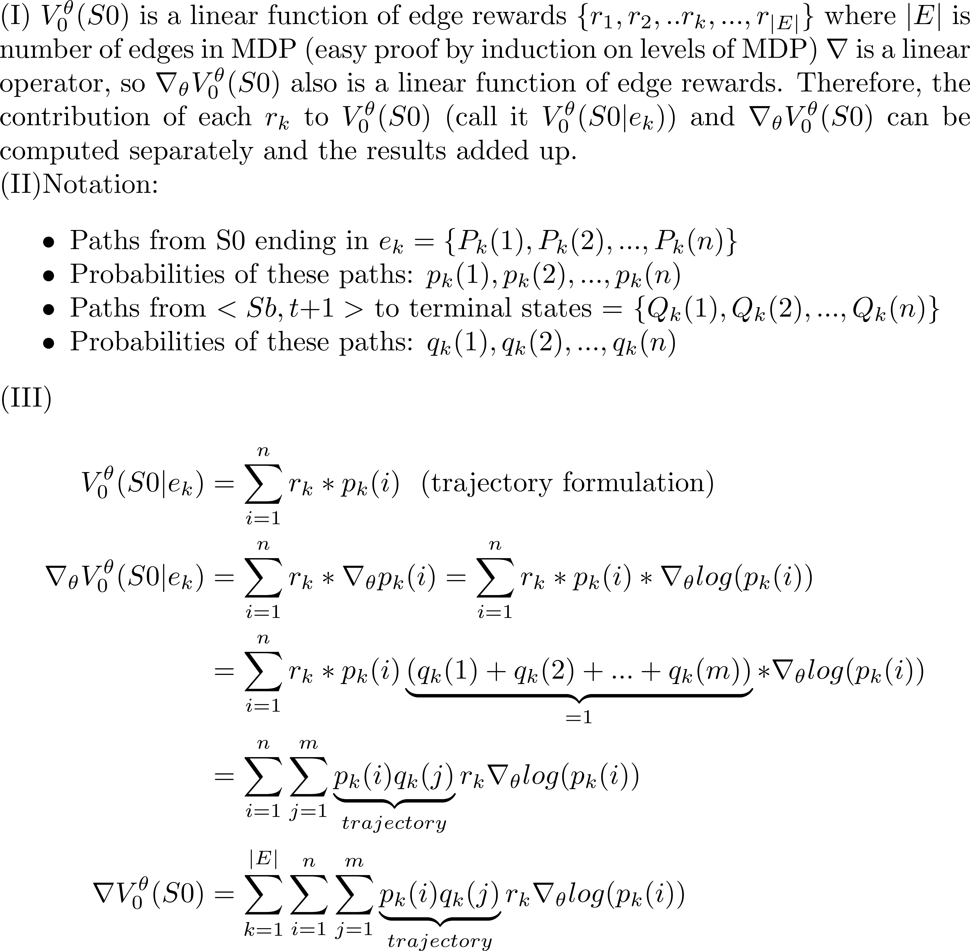
S0
V₀^{θ}
p_{k}(1)
p_{k}(2)
……
p_{k}(n)
Sa
V_{t}^{θ}
e_{k}
r_{k}
Sb
V_{t+1}^{θ}
q_{k}(1)
q_{k}(2)
q_{k}(m)
……
V_{T}^{θ}

Slide 22
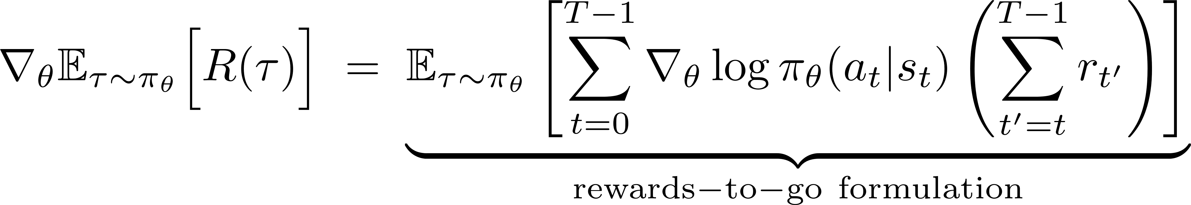
Rewards-to-go formulation
Three formulations have little to do with policy gradients or even reinforcement learning.
Given Bellman iteration over the MDP DAG as the gold standard for what we want to compute, the three formulations are just ways of computing over the set of DAG paths to get the same answer as Bellman iteration.
Policy gradient algorithms use rewards-to-go formulation with small twists.
τ:
r₀
r₁
r₂

Slide 23
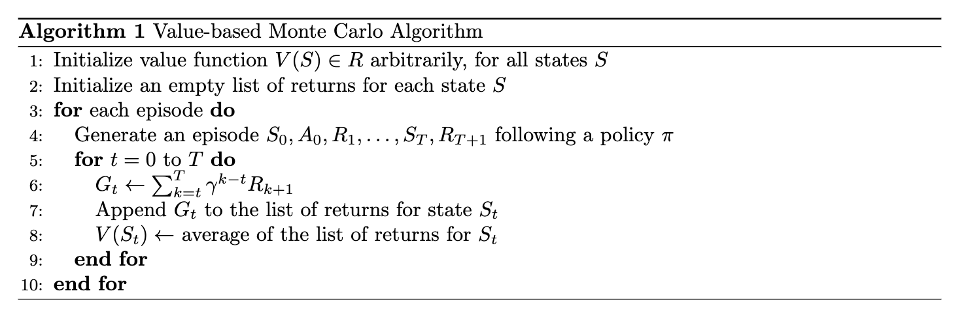
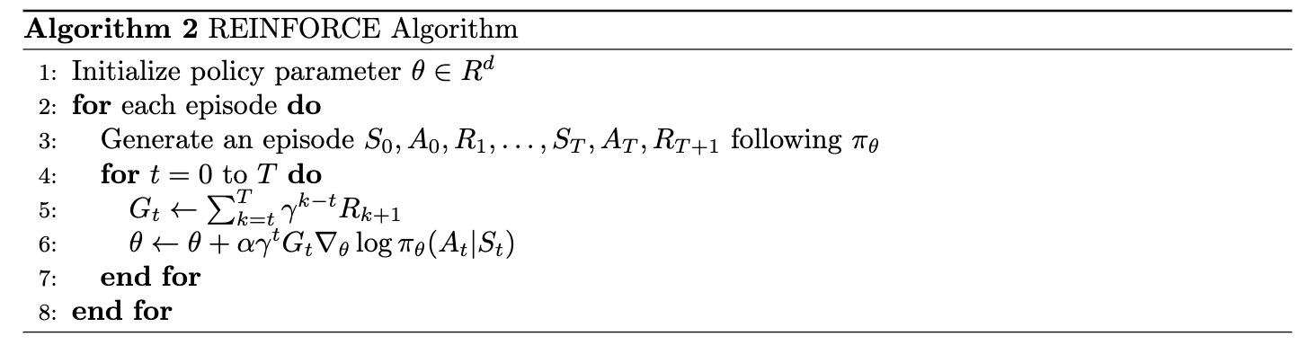
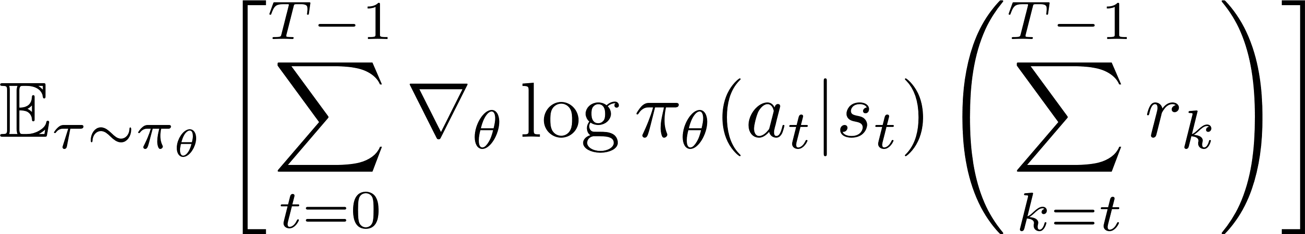
Policy-Based MC: REINFORCE Algorithm
Generate an episode starting at state 0 until state T following policy π
Discounted sum of rewards for episode
Update the value function for the state St
Generate an episode starting at state 0 until state T following policy π
Discounted sum of rewards for episode
Update the policy parameter θ using rewards-to-go
Policy gradient:
Notes:
Now that we showed how to do the policy gradient updates, we can look at the policy-based version of the MC method, REINFORCE, and compare it to the value-based version we looked at previously.

Slide 24
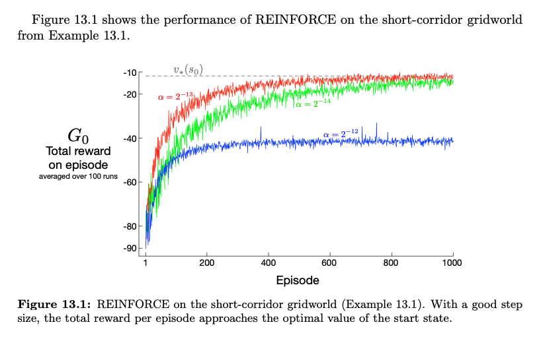
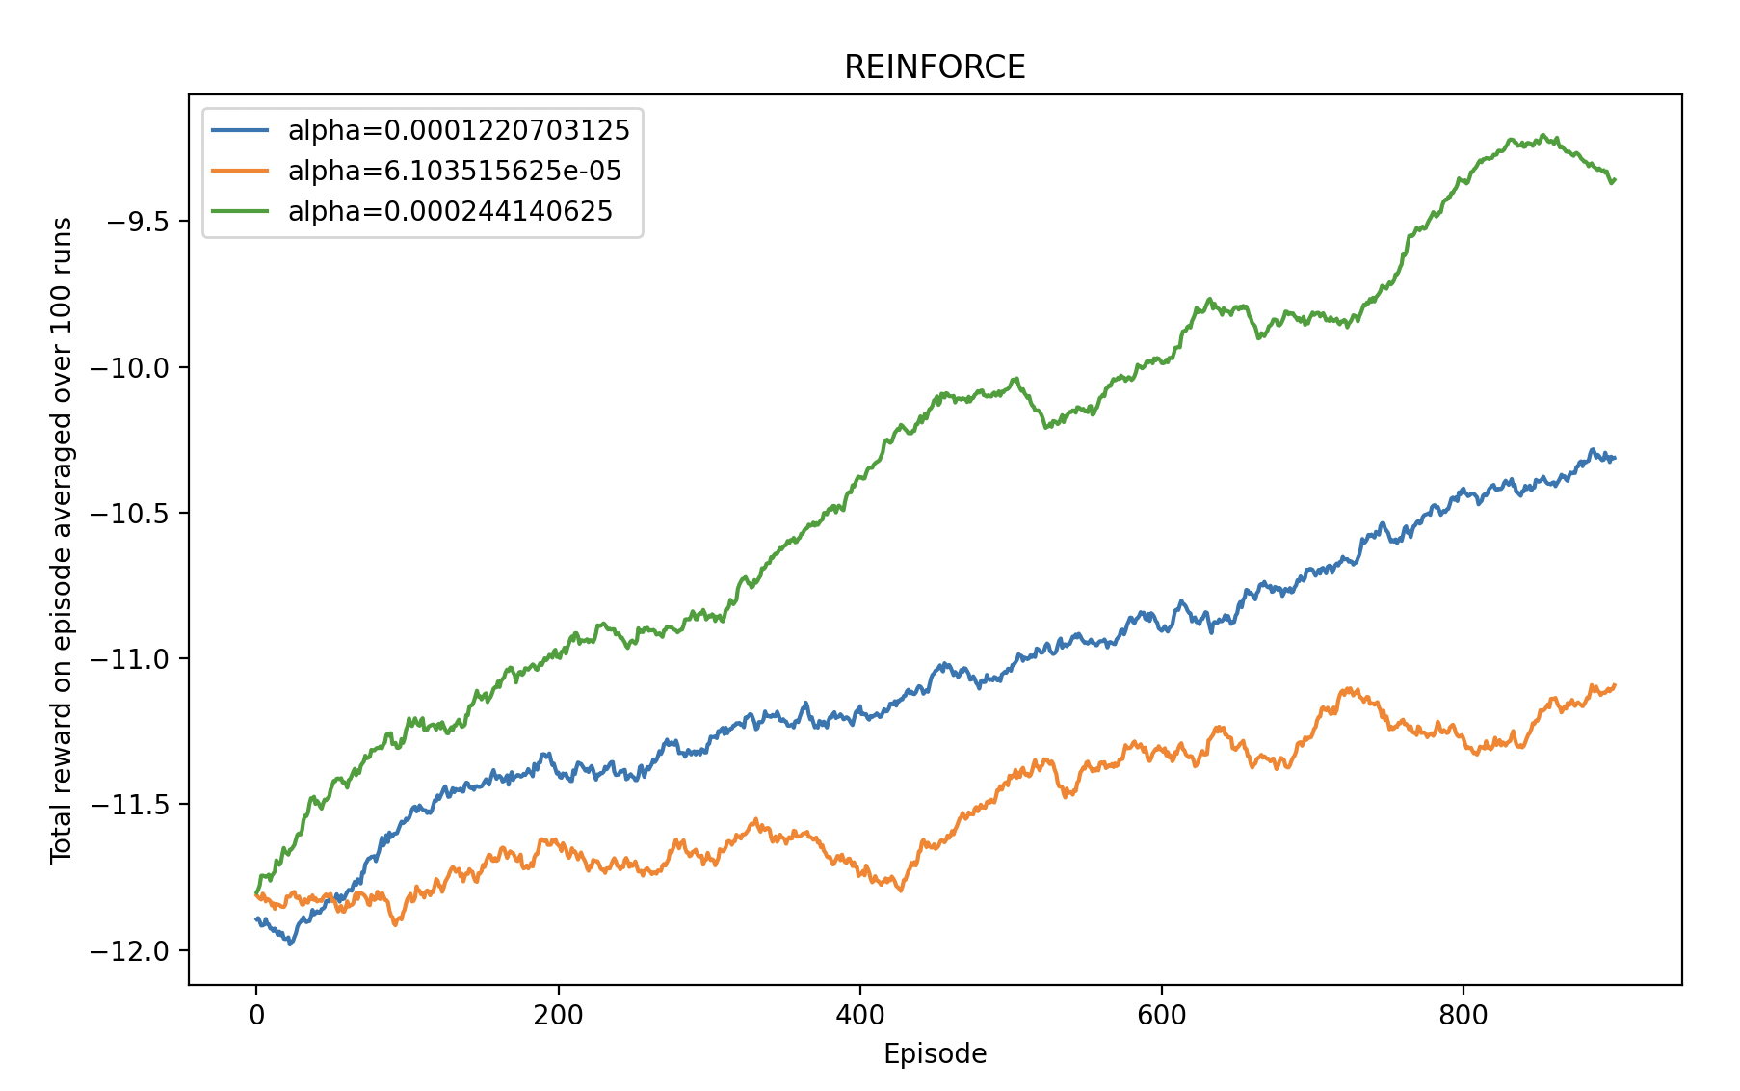
REINFORCE under different step sizes
Setting:
Notes:
Fluctuations / spikes -> high variance

Slide 25
Next talk
Deterministic and probabilistic control
Policy network π and its parameters θ
Basic policy gradient method: REINFORCE
Monte Carlo sampling to estimate gradient of expected reward
Suffers from high variance → requires many samples
Baseline methods for reducing variance
Based on control variates methods from Monte Carlo literature
Use advantage in place of reward
Implementation: actor-critic methods
Trust-region methods for improving stability and sample efficiency
Ensure updates to θ are small
Trust Region Policy Optimization (TRPO): KL-divergence
Proximal Policy Optimization (PPO): bounding box around current values

